Slide 1

Project Title – Seasonal Agriculture Performance Analysis
[Student Name: Manish Nishit Maity
College Name- Thakur Shyamnaryan Degree College ]
AICTE STU ID : STU6a6382e7d2f3b1784906471

Slide 2

PROBLEM STATEMENT
(Agricultural activities are influenced by seasonal variations in environmental conditions, farming practices, resource availability and market conditions. As a result, agricultural performance may differ from one season to another. However, raw agricultural data does not clearly explain how agricultural performance changes across seasons or what patterns can be observed in different seasonal conditions. The problem is to analyze the given agricultural dataset and investigate seasonal differences in agricultural performance by identifying meaningful patterns, trends, relationships and variations within the available data.

Slide 3
Project Description
This project analyzes a comprehensive agricultural dataset to investigate how seasonal variations (Kharif, Rabi, and Zaid) impact farming performance, resource usage, and economic outcomes. The analysis involved cleaning missing data and utilizing Python (Pandas, Matplotlib, and Seaborn) to perform exploratory data analysis. Key objectives included comparing profitability across different seasons, examining variations in resource utilization like water and fertilizer, and identifying relationships between environmental conditions and crop yield. Ultimately, the project provides data-driven insights and visualizations to support evidence-based agricultural planning and better seasonal decision-making.

Slide 4

WHO ARE THE END USERS?
Farmers: To figure out which crops are the most profitable in each season and to avoid wasting resources like water and fertilizer.
Government & Agricultural Planners: To understand seasonal farming trends so they can make better decisions about where to distribute resources.
Market Analysts: To track how costs, revenues, and profits naturally change during the Kharif, Rabi, and Zaid seasons.
Agricultural Researchers: To study exactly how different weather conditions (like rainfall and temperature) affect crop yield and pest risks.

Slide 5

Technology Used
Programming Language: Python
Development Environment: Jupyter Notebook (via VS Code)
Data Manipulation & Cleaning: Pandas
Data Visualization: Matplotlib and Seaborn
Version Control & Hosting: Git and GitHub

Slide 6
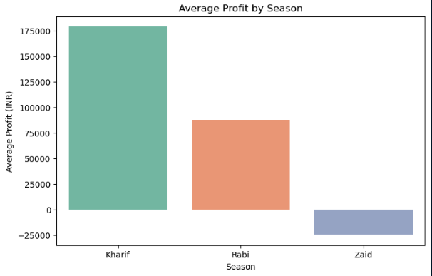
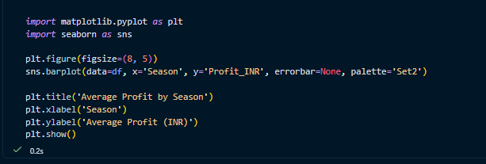
RESULTS
This chart compares the average financial return across the three main farming seasons.
Kharif is the most profitable: The Kharif season generates the highest average profit by a wide margin, nearing 175,000 .
Rabi shows moderate returns: Farming during the Rabi season remains profitable, but yields about half the financial return of Kharif.
Zaid operates at a loss: On average, agricultural activities during the Zaid season result in a financial loss (negative profit), dropping below zero.

Slide 7
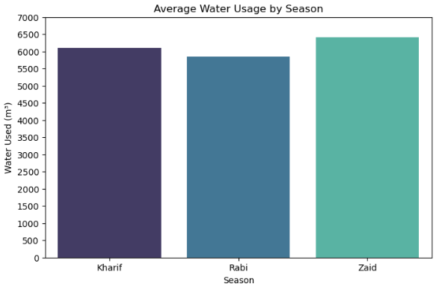
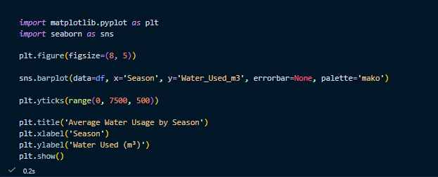
RESULTS
Highest Usage in Zaid: The Zaid season consumes the highest volume of water on average, nearing 6,500 m³.
Kharif and Rabi: Kharif follows closely behind with just over 6,000 m³, while the Rabi season is the most water-efficient, using the least amount of water overall.
Resource Efficiency: Comparing this to our profitability analysis reveals a major insight: even though Zaid consumes the most water, it operates at an average financial loss. In contrast, the water invested during the Kharif season yields a highly profitable return.

Slide 8
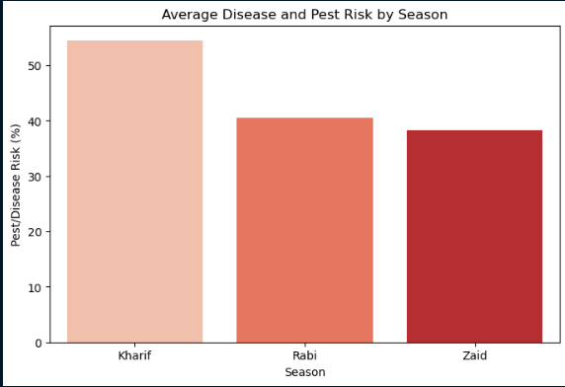
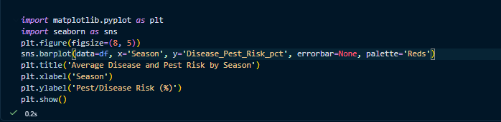
RESULTS
High Risk in Kharif: The Kharif season has the highest average risk for pests and diseases (around 54%). This makes sense, as Kharif coincides with the monsoon season, and high rainfall and humidity naturally create a breeding ground for pests.
Lower Risk in Rabi and Zaid: Both Rabi and Zaid show significantly lower pest risks (hovering around 38% to 40%).
Actionable Insight: This proves that while Kharif is the most profitable season (as seen on Slide 6), farmers must be heavily prepared with pest management strategies to protect their high-value crops during this time.

Slide 9
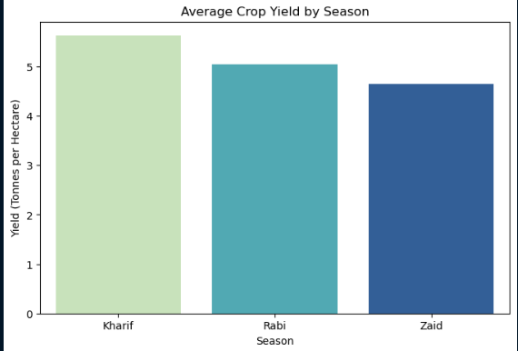
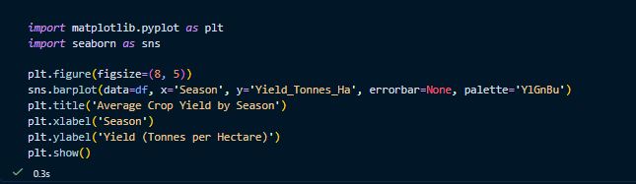
RESULTS
Highest Production in Kharif: The Kharif season produces the highest average crop yield, exceeding 5.5 tonnes per hectare. This aligns with our earlier findings that Kharif brings in the highest revenue and profit.
Moderate to Low Yields: Rabi maintains a solid yield of about 5 tonnes per hectare, while the Zaid season produces the lowest yield overall.
Resource to Yield Ratio: This highlights a major inefficiency during the Zaid season. As seen previously, Zaid consumes the most water but produces the lowest crop yield per hectare, ultimately explaining why it operates at a financial loss.

Slide 10
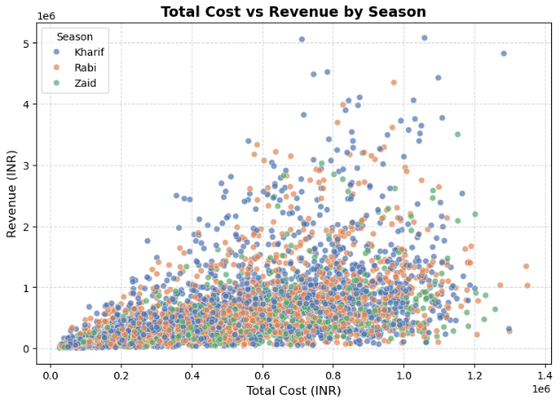
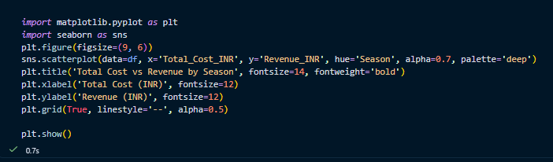
RESULTS
Kharif Reaches Higher Revenues: For any given level of investment (Total Cost), farms operating in the Kharif season consistently reach the highest revenue peaks (shown by the upper cluster of points).
Zaid's Economic Struggle: The data points for the Zaid season remain concentrated near the bottom of the revenue axis. Even when total costs increase, revenue fails to scale up, explaining the overall financial losses during this period.
Final Conclusion: Investment risk is lowest and potential reward is highest during the Kharif season, making it the most economically viable period for agricultural activities.

Slide 11
Future scope
Predictive Modeling: Instead of just looking at historical data, we could apply Machine Learning algorithms to predict crop yields and potential profits before a season even begins.
Interactive Dashboards: The analysis could be taken a step further by building an interactive Power BI dashboard. This would allow farmers or planners to filter by their specific district and instantly see which crop is best to plant.
Real-Time Weather Integration: We could merge this static dataset with a live weather API to study how sudden climate changes or unexpected droughts impact pest risks and water usage in real-time.

Slide 12
GitHub Link
https://github.com/manish130-ctr/Seasonal-Agriculture-Analysis

Slide 13

VOIS Course completion certificate -
Course name- Data Visualization

Slide 14
Thank you
.
.

